Slide 1

Case Study NYC AirBnb
Ummu Kalsum

Slide 2
Questions
Table of Interest : NYC AirBnB Dummy Data
Dataset Explenation : Link
Please answer the questions below.
1. Look at this data and start thinking. List down 3 trends/point that you want to show.
2. From here, try to explore the data and make changes,filter do the data preparation and cleaning as needed. You could use any tools as you wish, it’s not limited only to the tools that you have been taught throughout the mini course.
3. Create some vizualizations from the data and make 1-2 slide from each visualizations with the insight you got to present your findings to the stakeholders (read this article from HBR).

Slide 3

01
Defining the Problems

Slide 4
Defining the Problems
1. what is Airbnb largest segment of rented properties ?
2. How many properties are there in each borough?
3. How is the rental price distribution for each room type?

Slide 5

02
Data Cleaning

Slide 6
Data Cleaning
Messy data is a common problem you’d likely face when you have data from sources like spreadsheets. It is important to clean your data before doing any anlysis.
Things to do in data cleaning :
Change datatype
Remove duplicated data
Remove empty data
Remove outliers
Remove unnecessary data

Slide 7

04
Data Visualization

Slide 8
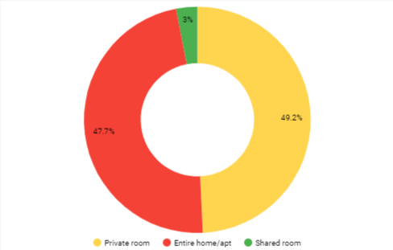
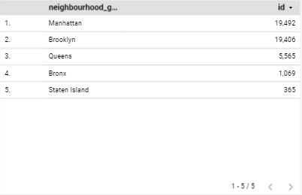
Data Visualization with Insight
With total of almost 46K listing, the biggest segment of rented AirBnB properties in NYC is "Entire Home/Apartment". Most properties are located in Manhattan and Brooklyn.
1. Percent of Rented Properties by Room Type
2. Number of Rented Properties by Neighbourhood Group
id
45,897

Slide 9
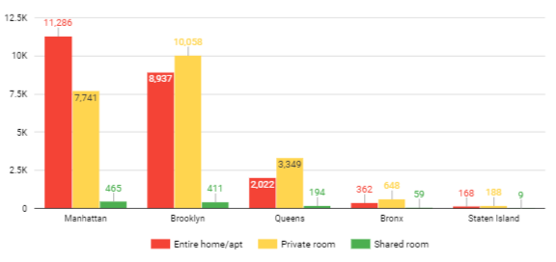
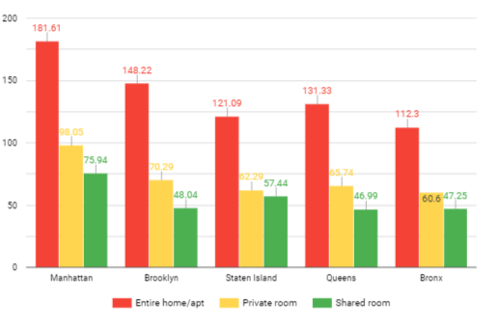
3. Number of Rented Properties by Room Type by Neighborhood Group
Generally, the price of the entire home/apt property type is highest compared to private room type and shared room type.
The properties having the highest rental price are those located in Manhattan (even the average shared room rental price in Manhattan is slightly higher than private room in Brooklyn!)
Average Price of Rented Properties by Room Type by borough

Slide 10


Tools

Slide 11


THANKS
ummukalsum1297@gmail.com
www.linkedin.com/in/ummukalsumfn
https://github.com/UmmuKalsumFn/Portofolio_Data

